Slide 1

FIFA World Cup 2026 Healthcare Systems Update
May 23, 2025

Slide 2
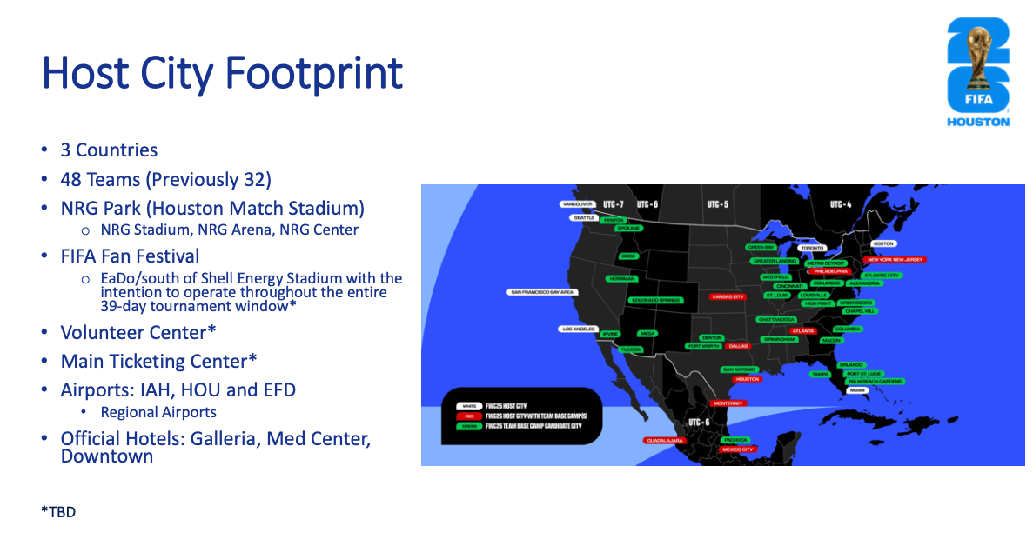
Notes:
LA just having a match – white
San Antonio just serving as base camp – green
Base Camp and Games – Red
Population surges of 50-300,000

Slide 3
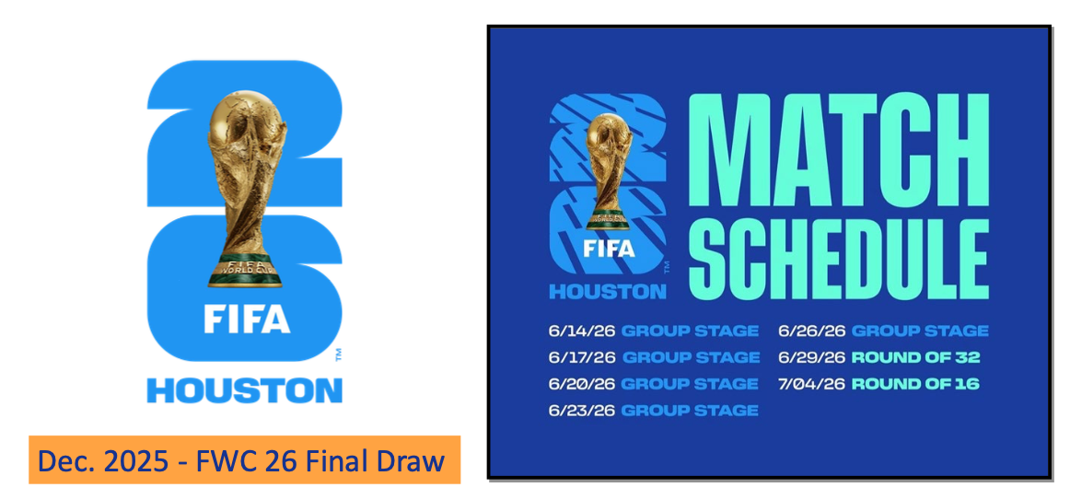

Slide 4
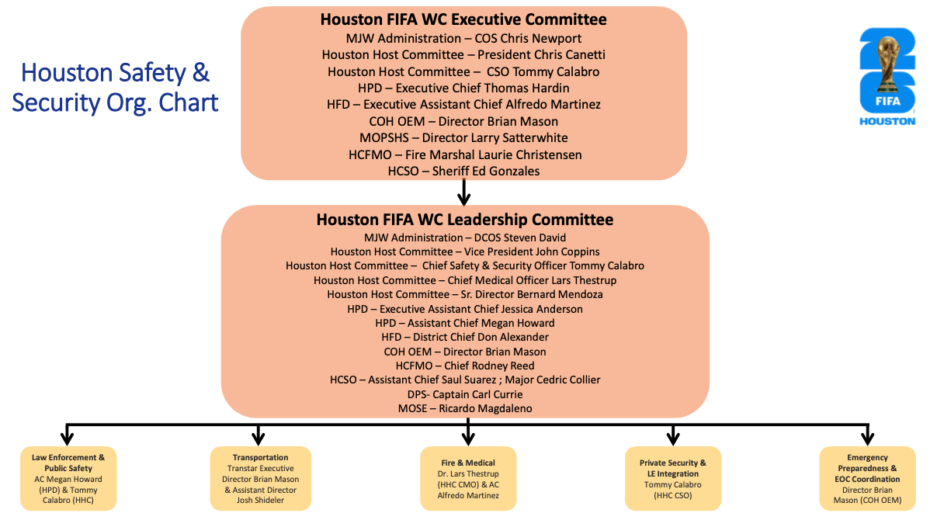

Slide 5
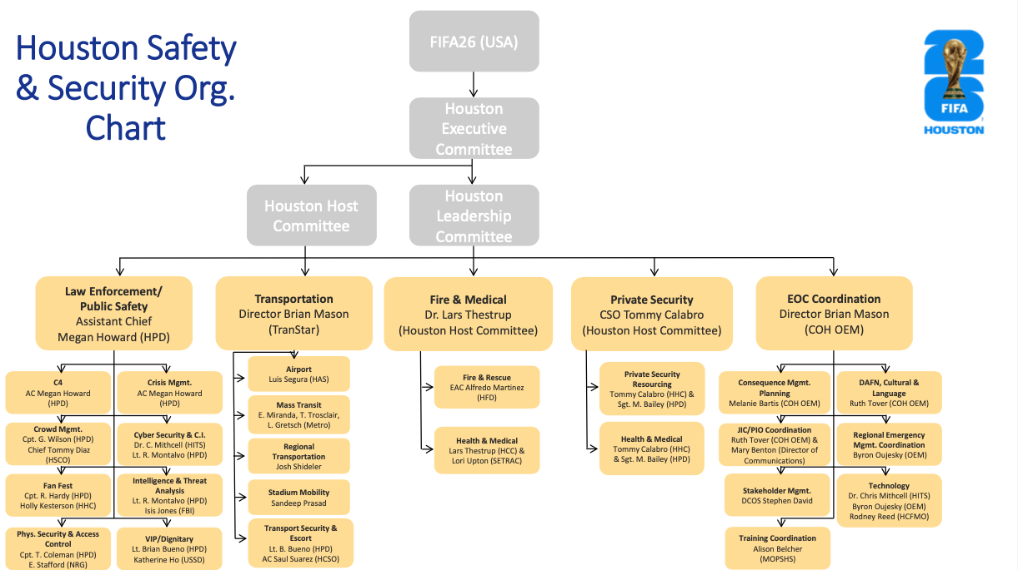

Slide 6

Host City Areas of Responsibility
NRG Stadium
  Spectator Medical Clinic in NRG
  Exterior medical aid station on stadium grounds
Media Center
  Fixed / Mobile Medical Teams
Mile Marches
  Medical Coverage of 2 separate teams entering NRG
  Approximately 1 mile March
FanFest
  Full medical coverage
Training Site Ambulance Coverage
  1 ALS Ambulance standing by for practices
Hotel Coverage
  <10 Minute Response Time
Public Health Plan

Slide 7
NRG Stadium
Onsite Stadium Unified Command
Spectator Medical Center
Player Medical Center
VIP/VVIP Medical Centers
Exterior Medical Aid Station (North and South)
Exterior EMS Response
  17 onsite AMR units
  2 HFD Strike Teams North/South of stadium outside of footprint
Media Center – NRG Center
Modified Bus Service for Med Center – similar to Rodeo

Slide 8
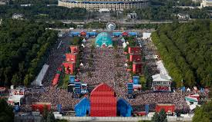
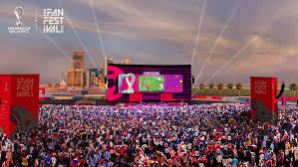
FanFest
Operational Period: 6/11/26 – 7/19/26 (39 days)
Location: EaDo
Approximately 5,000/day up to 15,000
  Max Capacity 5,000
Only 5 days where there are no matches being played in the Americas
Matches televised for attendees

Slide 9
-Medical Tent – Minor emergencies
-Staged HFD Units
-Alternative Destinations for Txp
-ETHAN
-Sobriety Center

Slide 10
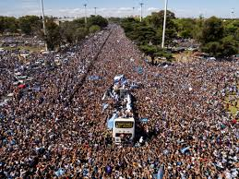
Mile Marches
Unknown Number Marching – Team dependent
Occur on game days
Believe starting South of stadium
Pop Up Marches a likely possibility
2 separate simultaneous (or near simultaneous) marches into stadium
HFD Request: Chief Mobley

Slide 11
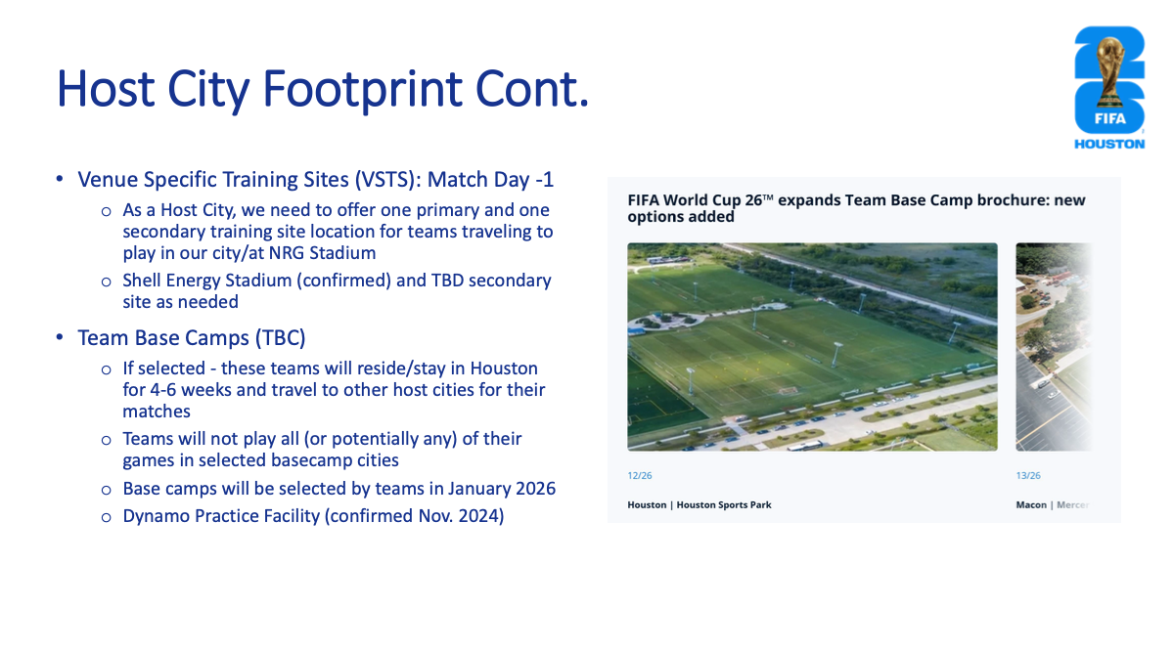

Slide 12
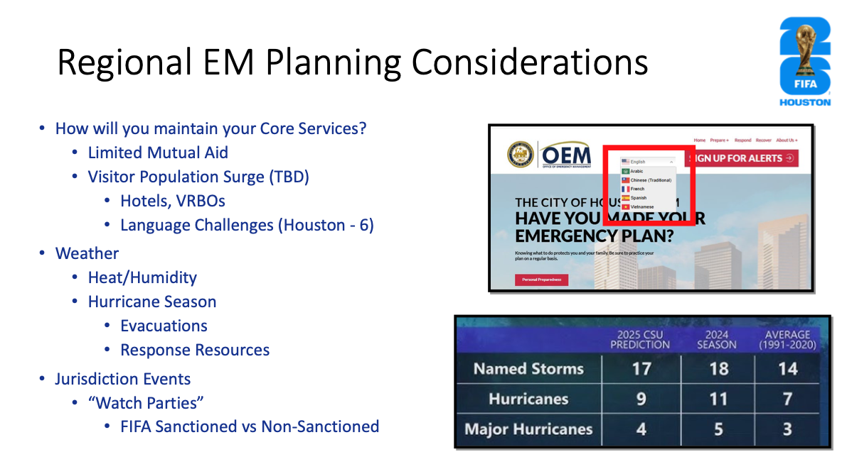
Notes:
What are you going to seeThe ask, we need capacity. We need to be able to send patients to our local hospitals. We will see population surges of up to 300,000 depending on the teams, this is a party atmosphere with alcohol mixed with a Houston summer. International Insurance

Slide 13
Contact Information
Lars Thestrup, MD
  Chief Medical Officer
  FIFA Houston World Cup 2026
  lthestrup@fwc26houston.com
Rusty Mobley
  Assistant Chief EMS
  Houston Fire Department
  Rusty.Mobley@houstontx.gov

Slide 14


