Slide 1
HCA Healthcare Houston Northwest Medical Center
Hospital Violence Intervention Program (HVIP)
Shiree A. Berry, M.D., FACS
Trauma & General Surgeon
Regional Trauma Medical Director
Trauma Medical Director- HCA Houston Healthcare Northwest Medical Center
Vice Chair, Department of Surgery- HCA Houston Healthcare Northwest Medical Center
Clinical Assistant Professor in the Department of Clinical Science- Tillman J. Fertitta Family College of Medicine
Chandra Seigrist, MSN, RN
Trauma Education and Outreach Specialist

Slide 2
EPIDEMIOLOGY
100K Non-Fatal Firearm Injuries/Year
39K Fatal Firearm Injuries/Year
100 Persons/Day Killed
19 Children Shot Today
Over 40 Years = 1.2 Million Deaths

Slide 3








Slide 4

THE IMPACT: HEALTHCARE
Annual Cost
300
Uncompensated Trauma Funds:
$852 million
Preparedness & Prevention:
$280 million
Security & Safety:
$1.1 million
Healthcare Facility Related Violence:
$429 million
200
100
0
2016
2017
2020

Slide 5

THE IMPACT: HEALTHCARE
Acute & Long-Term Effects
  Devastating Disability
  Long Hospital Lengths of Stay
  Discharge Planning and Disposition Issues
  Accessibility to Social Work
  PTSD, Depression, Anxiety
  Unemployment, Decreased Productivity
  Family Impact
HCA HOUSTON HEALTHCARE NORTHWEST
GULF COAST DIVISION

Slide 6

BREAKING THE CYCLE
106 Patients
102 Patients with 2
4 Patients with > 3

Slide 7

VIOLENCE AS A PUBLIC HEALTH ISSUE
Notes:
A multidisciplinary working group, Improving the Social Determinants of Health to Attenuate Violence, or ISAVE, was established in 2019 by the ACS COT. The ISAVE workgroup proposes four strategies to improve health and health care for marginalized communities that are disproportionally impacted by violence: Development and implementation of Trauma Informed Care in all trauma centers; Integrating social care into trauma care; The trauma center’s role in investing in at-risk communities; Advocacy

Slide 8
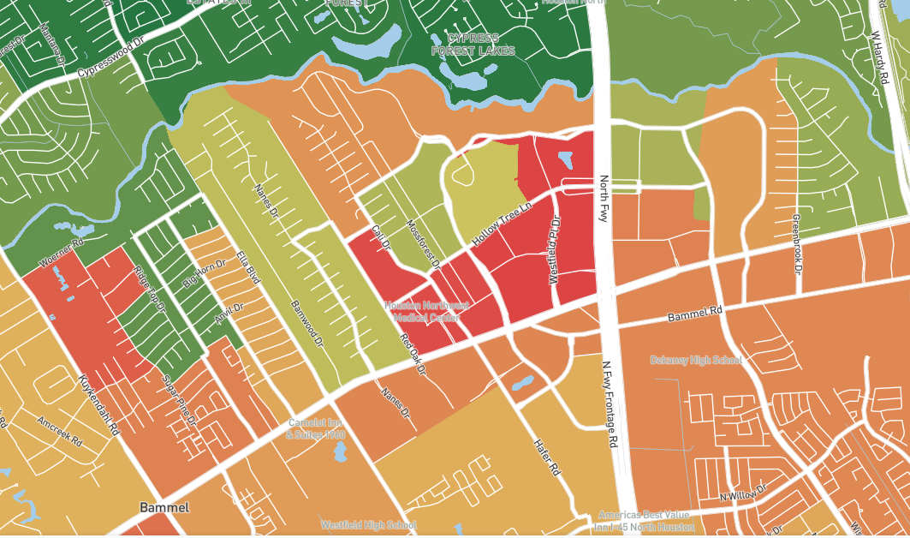
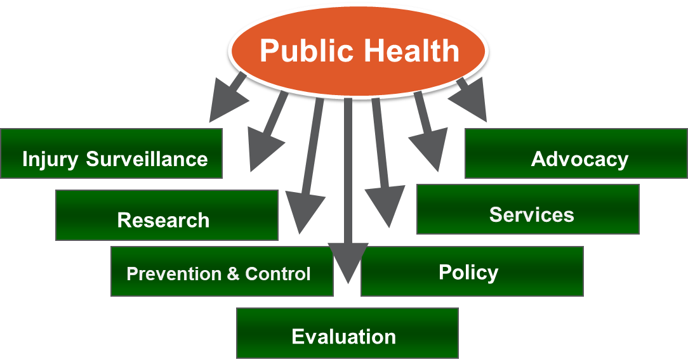


THE TRAUMA CENTER’S ROLE IN PUBLIC HEALTH & PREVENTION
77090, 77021, 77033, 77051
Risk Reduction strategies can be provided in trauma centers
  Utilize the “Teachable Moment”
  Culturally competent case management at bedside
  Community partnerships

Slide 9
WHAT IS HVIP?
Hospital Linked vs Hospital Based
Resources
Community Outreach
Mental Health Referrals
Notes:
Hospital-based violence intervention programs (HVIPs) represent an important example of how trauma centers are incorporating social care into trauma care.
HVIPs have the following 3 essential tenants: 1. Identification of high-risk individuals in the hospital after a violent injury.
Engagement of these patients, at the bedside, by culturally appropriate violence prevention professionals. Many HVIP frontline workers have lived experience from a similar background and are immediately seen as credible messengers and potential mentors to victims of violence.
Development of an individual needs assessment by the violence prevention professional and the HVIP client. The violence prevention professional connects the client with mental healthcare and risk reduction resources in the community to address their SDH. This portion of care might focus on employment; education; navigating government and legal systems; housing and relocation; and a number of important ancillary services, such as tattoo removal, mapping out safe transportation, and other needs. This occurs in concert with mental healthcare and substance abuse services as needed. The relationship of the client and the violence prevention professional typically lasts for months, but unofficially often extends beyond any official timeline. HVIPs represent a model of equity care. Instead of providing “one size fits all” services, the type and intensity of services are based on individual need.

Slide 10


Notes:
Access Harris. (Accessing Coordinated Care and Empowering Self Sufficiency)

Slide 11
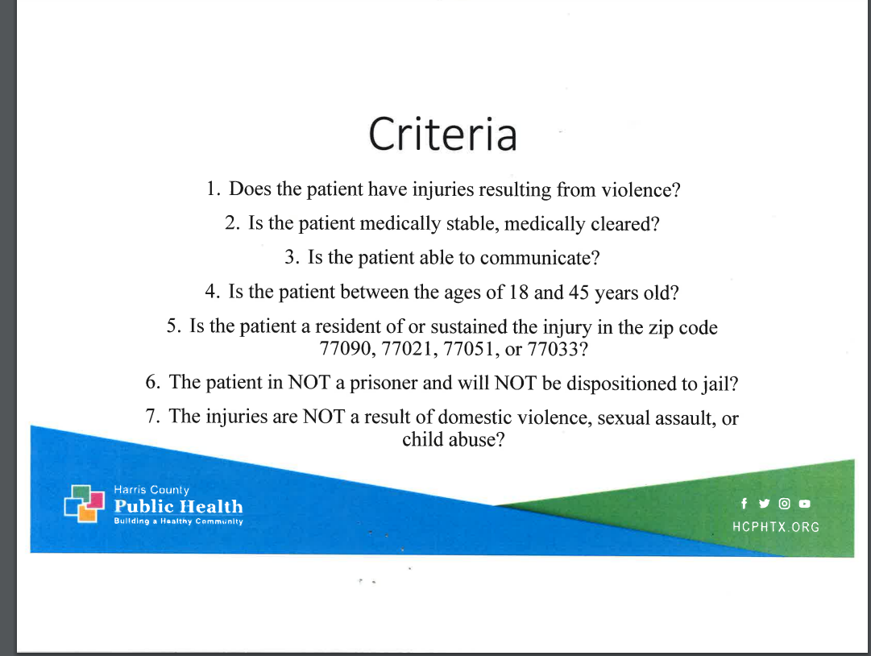

Slide 12
NOVEMBER
2022
HCA HNW
HVIP ROLLOUT
HVIP PROCESS
Morning Report
Criteria
Consents
Warm Handoff to the Outreach Specialist
Notes:
Support and assistance will continue after survivors leave the hospital.
Provide long-term, intensive case management of these individuals through a coordinated care approach. In collaboration with other agencies the Harris County’s Accessing Coordinated Care and Empowering Self Sufficiency (ACCESS) will direct them to access a variety of support services, including:
Employment; Mental health assistance; Substance abuse prevention; Childcare; Transportation; Food and Housing

Slide 13
CURRENT STATISTICS
154 Participants Offered Services
20 declines
1 Mortality from future violence
1 Readmission for violence

Slide 14
SUCCESSES
Retaliation Prevention
Decrease in Recidivism
Increased Community Engagement and Perception
Notes:
Other Programs:
Services most strongly associated with success: employment and mental health support
San Fran Recidivism from violent injury significantly lower compared to historical controls (16 vs 4.5%)
UVA Hospital Decrease Violence Recidivism from 15% to 3.6%; Improved ED resource utilization and clinic visits
UVA Community services : > 90% connected to community service programs, including mental health, employment internships

Slide 15
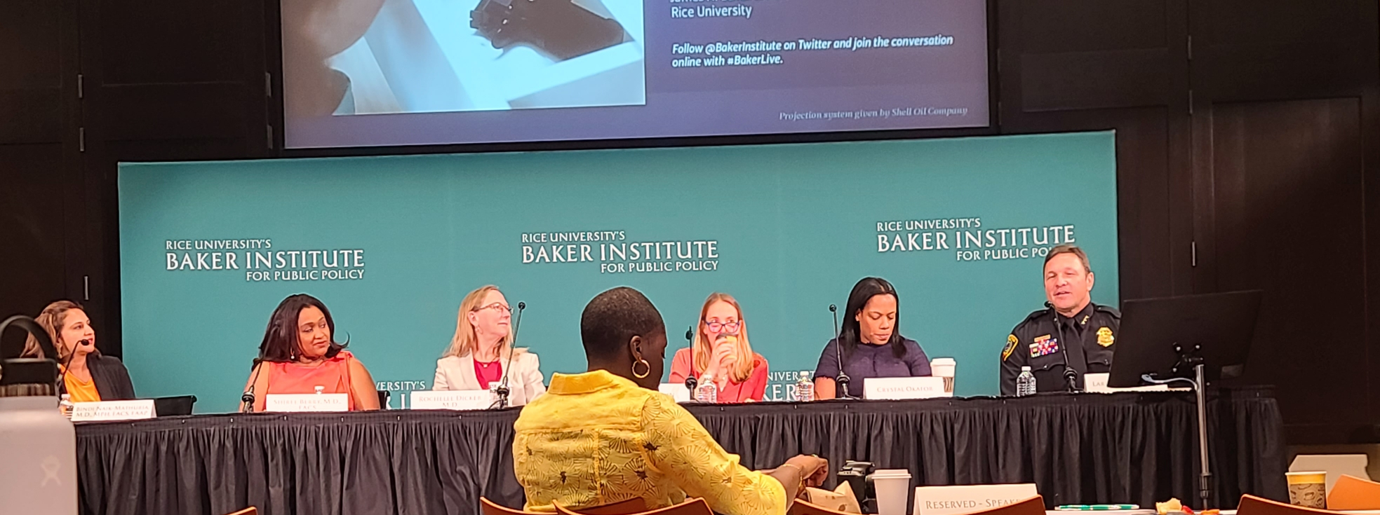


FUTURE DIRECTIONS
Research
  Data Collection
HLVIP vs HBVIP
  In House 24/7
Expansion to other HCA Trauma Centers
Increased Language Ability
Project Inspire
School Based Partnerships

Slide 16
RESOURCES
American College of Surgeons Committee on Trauma
The Health Alliance for Violence Intervention (HAVI) www.TheHavi.Org
Harris County Public Health- Community Health and Violence Prevention Services
White House Office of Gun Violence Prevention
EndCommunityViolence.com; American Rescue Plan
Boston Medical Center VIAP; Bridging the Gap in Richmond, VA; Oakland’s Youth Alive/Caught in the Crossfire; Wrap Around Project in San Fran
Co-SERVE
Shiree.Berry@hcahealthcare.com; Chandra.Siegrist@hcahealthcare.com
Notes:
The COT has a partnership with the Health Alliance for Violence Intervention, an umbrella organization that promotes scaling up, evaluation, advocacy, and sustainability of HVIPs nationally. A roadmap for development and sustainability of HVIPs, along with best practices, was produced by the ACS COT as a result of this partnership.²³ Evaluation of efficacy of HVIPs should include a qualitative component to include the most essential voice—that of the client.
A multidisciplinary working group, Improving the Social Determinants of Health to Attenuate Violence, or ISAVE, was established in 2019 by the ACS COT.

Slide 17
QUESTIONS?

