Slide 1

SETRAC Maternal Workgroup
Weekly COVID19 Update: Outpatient management
Eugene Toy, MD
Carey Eppes, MD
Christina Davidson, MD
June 1, 2020

Slide 2
Agenda
Review some pointers on pregnant and postpartum management
Hospital discussion

Slide 3
Q1. How many COVID+ patients have you seen on your unit in the past 2 week?
A. 0
B. 1 to 5
C. 6 to 10
D. 10 to 20
E. More than 20

Slide 4
Q2. Have you had any critically ill/ICU COVID OB patients?
YES
NO

Slide 13
Status Report from Hospitals
Briefly state your name, your hospital, current COVID pts or issues over past 2 weeks, your plans for prep for potential surge

Slide 14
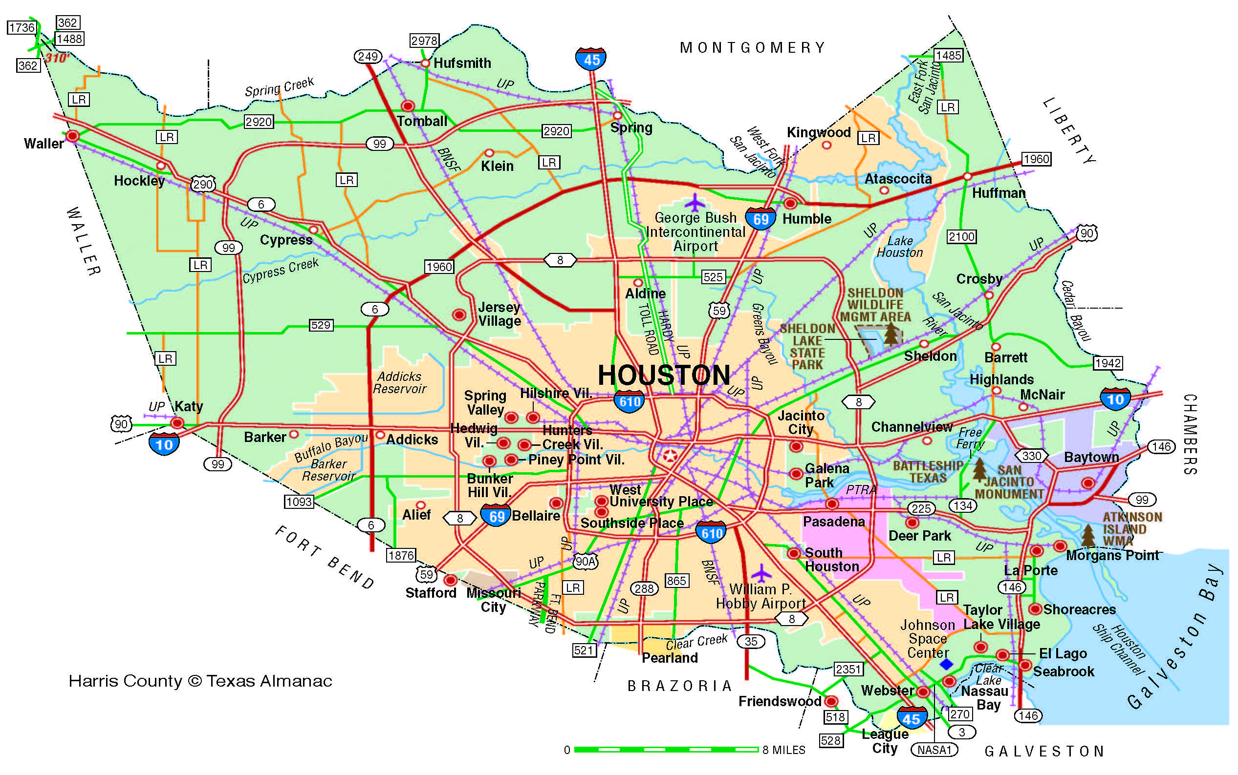
Other Counties outside of Harris and adjacent
Your name, hospital
COVID+ experience
Challenges
Any novel treatments tried

Slide 15
Harris County: East
Your name, hospital
COVID+ experience
Challenges
Any novel treatments tried

Slide 16
Harris County: North & NW & Mont Cnty
Your name, hospital
COVID+ experience
Challenges
Any novel treatments tried

Slide 17
Harris County: Inside 610 Loop
Your name, hospital
COVID+ experience
Challenges
Any novel treatments tried

Slide 18
Harris County & Fort Bend Cnty: South & SW
Your name, hospital
COVID+ experience
Challenges
Any novel treatments tried

Slide 19
Conclusions
Slight numbers of COVID+ in Harris County
Less critically ill patients including OB patients
Need to be prepared – learn from each other
https://s3.amazonaws.com/cdn.smfm.org/media/2383/Practical_guidance_LMIC_05-20-20.pdf

