Slide 1

SETRAC Maternal Workgroup
Weekly COVID19 Update: Outpatient management
Eugene Toy, MD
Carey Eppes, MD
Christina Davidson, MD
May 4, 2020

Slide 2
Agenda
Review some pointers on outpatient management
Hospital discussion

Slide 3
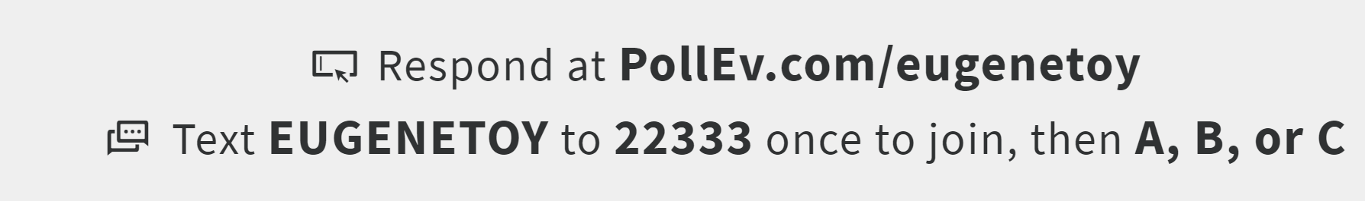
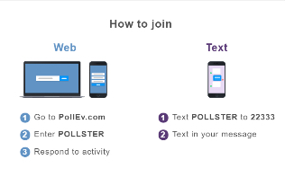
Text eugenetoy to 22333
eugenetoy

Slide 4
Q1. How many COVID+ patients have you seen on your unit to date?
A. 0
B. 1 to 5
C. 6 to 10
D. 10 to 20
E. More than 20

Slide 5
Q2. Have you had any critically ill/ICU COVID OB patients?
YES
NO

Slide 6
SMFM published COVID high risk guidelines on April 30, 2020
https://s3.amazonaws.com/cdn.smfm.org/media/2336/SMFM_COVID_Management_of_COVID_pos_preg_patients_4-30-20_final.pdf

Slide 8
Concept #1: Severity Scale

Slide 16
Outpatient management

Slide 18
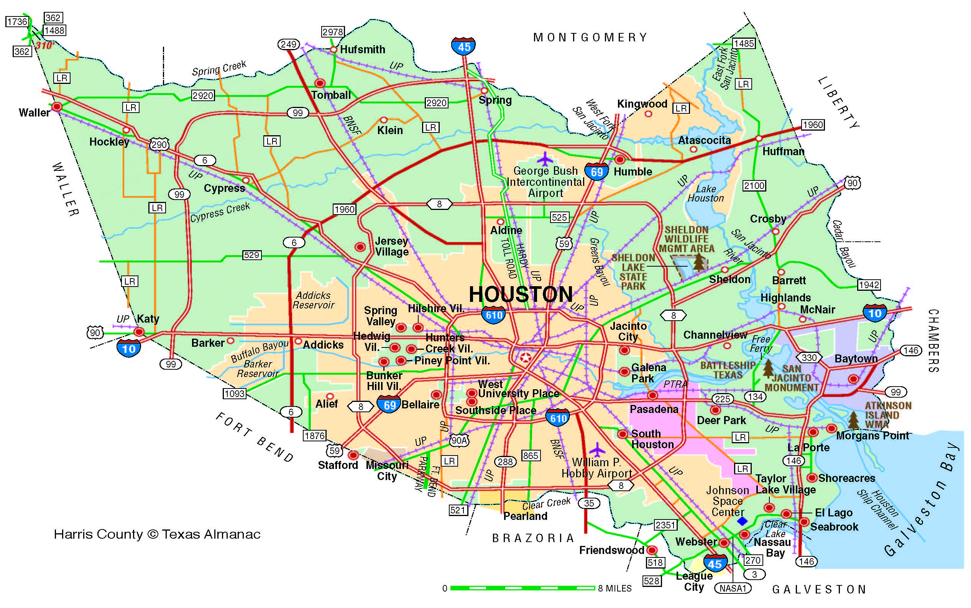
Harris County: North & NW & Mont Cnty
Your name, hospital
COVID+ experience
Challenges
Any novel treatments tried

Slide 19
Harris County: East
Your name, hospital
COVID+ experience
Challenges
Any novel treatments tried

Slide 20
Other Counties outside of Harris and adjacent
Your name, hospital
COVID+ experience
Challenges
Any novel treatments tried

Slide 21
Harris County: Inside 610 Loop
Your name, hospital
COVID+ experience
Challenges
Any novel treatments tried

Slide 22
Harris County & Fort Bend Cnty: South & SW
Your name, hospital
COVID+ experience
Challenges
Any novel treatments tried

Slide 23
Conclusions
Slight numbers of COVID+ in Harris County
Less critically ill patients including OB patients
Need to be prepared – learn from each other

