Slide 1

SETRAC Maternal Workgroup
Weekly COVID19 Update: Outpatient management
Eugene Toy, MD
Carey Eppes, MD
Christina Davidson, MD
May 11, 2020

Slide 2
Agenda
Review some pointers on pregnant and postpartum management
Hospital discussion

Slide 3
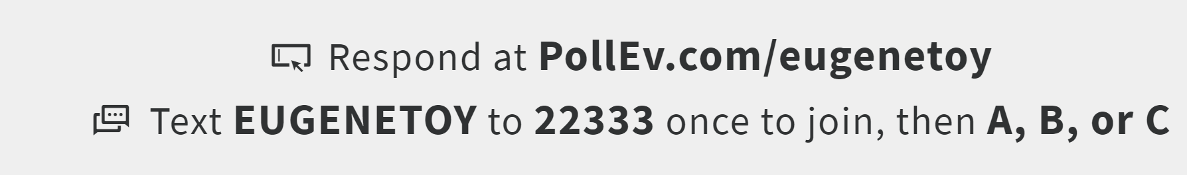
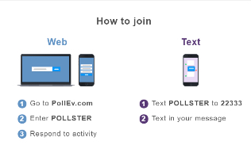
Text eugenetoy to 22333
eugenetoy

Slide 4
Q1. How many COVID+ patients have you seen on your unit to date?
A. 0
B. 1 to 5
C. 6 to 10
D. 10 to 20
E. More than 20

Slide 5
Q2. Have you had any critically ill/ICU COVID OB patients?
YES
NO

Slide 10
These investigators found that proning pregnant women even in the third trimester to be safe and well tolerated with the right support.

Slide 11
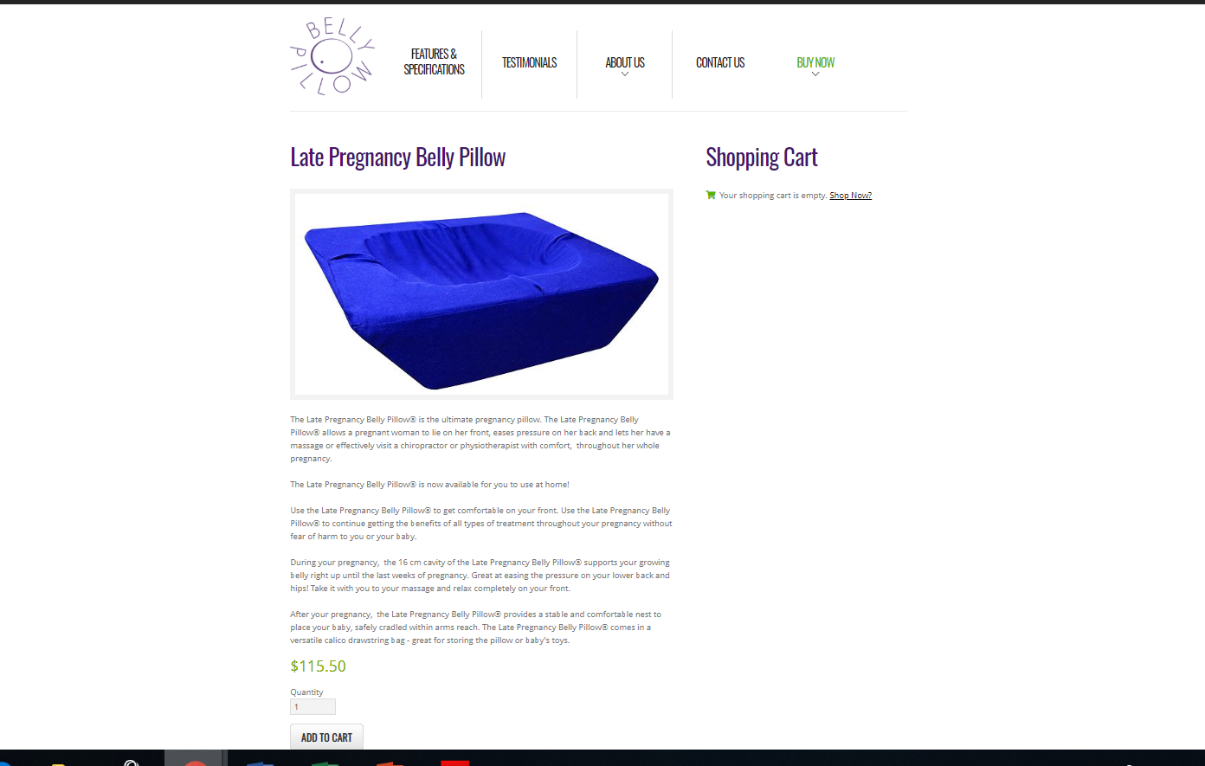
Bellypillow.com
$115.50

Slide 23
NOTE: 95% SpO2 = 90 mm Hg (NOT 70 mm Hg)
High flow NC preferred over mechanical ventilation

Slide 32
https://emcrit.org/wp-content/uploads/2020/04/2020-04-12-Guidance-for-conscious-proning.pdf
https://journals.lww.com/greenjournal/Abstract/9000/Acute_Respiratory_Distress_Syndrome_in_a_Preterm.97348.aspx
https://www.ajog.org/article/S0002-9378(20)30197-6/pdf

Slide 33
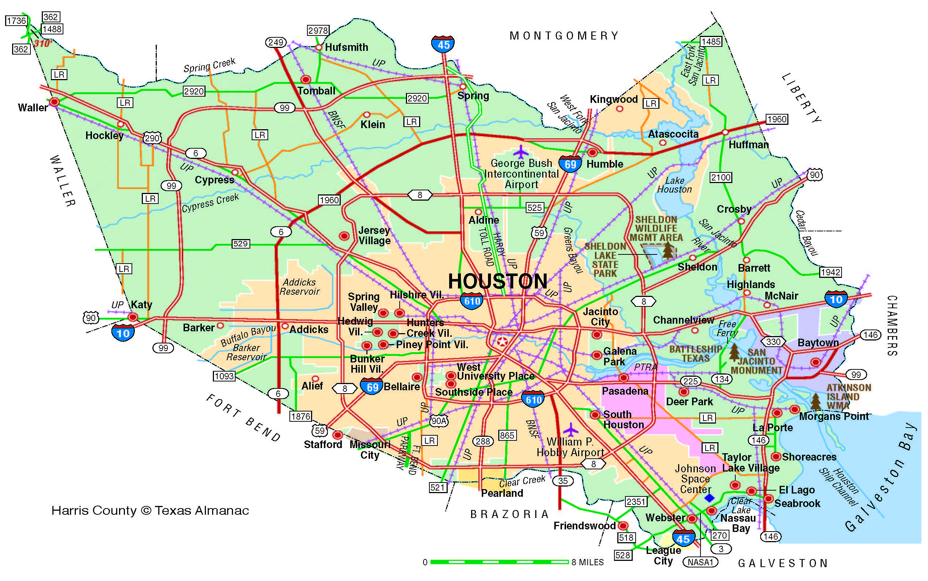
Harris County: North & NW & Mont Cnty
Your name, hospital
COVID+ experience
Challenges
Any novel treatments tried

Slide 34
Harris County: East
Your name, hospital
COVID+ experience
Challenges
Any novel treatments tried

Slide 35
Other Counties outside of Harris and adjacent
Your name, hospital
COVID+ experience
Challenges
Any novel treatments tried

Slide 36
Harris County: Inside 610 Loop
Your name, hospital
COVID+ experience
Challenges
Any novel treatments tried

Slide 37
Harris County & Fort Bend Cnty: South & SW
Your name, hospital
COVID+ experience
Challenges
Any novel treatments tried

Slide 38
Conclusions
Slight numbers of COVID+ in Harris County
Less critically ill patients including OB patients
Need to be prepared – learn from each other

